Slide 1
Guilford College
Faculty Salary Formula Sub-committee
of the
2015-16 Compensation Committee
May 6, 2016
Notes:
Christine

Slide 2
Faculty Salary Formula Sub-committee:
Who we are:
Daniel Diaz
Hiroko Hirakawa
Christine Riley
Natalya Shelkova
Richie Zweigenhaft
Notes:
All

Slide 3
What do we want this formula to accomplish?
Align with Guilford Values:
Excellence, Diversity, Justice, Equality
Create Clarity:
Transparency, Predictability, Consistency
Build Trust:
Reduce resentments engendered by past practices
Notes:
Christine

Slide 4
Values Question #1:
Should there be a salary differential
based on academic discipline?
Values Dilemma:
Excellence vs. Equality/Justice
[all work is equally valued]
Notes:
Daniel

Slide 5
Intentional Salary Difference by Discipline
Pros:
Consistent with our value of Excellence
Recruit credentialed faculty in high demand fields - fewer people available for those positions
Recruit excellent faculty in all fields
Cons:
Not consistent with Guilford values of Equality and Justice.
Does not honor all faculty work equally.
Perpetuates and privileges the gender, race, and other biases current reflected within the market.
Notes:
Daniel

Slide 6
Values Question #2:
Should our desire to truly value diversity
be reflected in our salary model?
Values Dilemma:
Diversity vs. Equality
[all work is equally valued]
Notes:
Hiroko

Slide 7
Intentional Salary Difference to Enhance Diversity
Pros:
Allows us to compete with other colleges to hire faculty from diverse backgrounds - some are in great demand [consistent with our value of Diversity & Excellence]
Recognizes the additional burden that some faculty bear in mentoring students, and other unacknowledged workload issues
May help balance out the bias and discrimination that is built into the employment market
Cons:
Does not equally value all faculty work [works against our value of Equality]
It’s questionable whether it is legal - courts have gone both ways
Defining diversity for this purpose, and deciding what attributes we will privilege, is a deeply troubling and complex matter. It would be very easy to get this wrong.
Notes:
Hiroko

Slide 8
DRAFT Faculty Salary Equity Formula
Discipline
Premium
[market]
Phase Out
Credit for
Years of
Experience
TARGET
SALARY
Base Pay
Per Rank
+
Terminal
Degree
+
+
=
Notes:
Richie

Slide 9
DRAFT Faculty Salary Equity Formula
=
TARGET
SALARY
[Equity]
+
Other options:
* Cost of Living Increase
* Merit Increase
* Endowed professorship
* Diversity considerations
RANK
Instructor
Assistant
Associate
Professor
BASE
$45,000
$52,000
$63,000
$80,000
DEGREE
$5,000
$5,000
$5,000
$5,000
DISCIPLINE
[Market]
%
of
$15,000
Phase
out
over time
CREDIT
FOR
EXPER-
IENCE
$200
per
year
Notes:
Richie

Slide 10
Market Factors by Discipline* - Example
Market Factor = $15,000
Disciplines: % Market Factor Added to Base Salary
Humanities/ Social Sciences/ Education
Arts / Peace Studies / etc. 0% $ 0
Criminal Justice/ Geology / Some Foreign Languages /
Some subdisciplines in Math / Economics, etc. 35% $ 5,250
Chemistry / Health Sciences
Sport Sciences, etc. 50% $ 7,500
Business Management 70% $10,500
Accounting, Computer Science, Network Security 100% $15,000
Notes:
Richie

Slide 11
Crediting Prior Experience* Example
Years of credited experience =
100% College teaching, full-time
75% Related professional experience
60% High School / other FT teaching
40% Teaching Assistant/Graduate Assistant teaching
Notes:
Richie

Slide 12
Example #1: Target Salary Calculations
Sarah
Second year as Assistant Professor in Guilford's Chemistry Department.
Came to Guilford with:
2 years of high school teaching
3 years of Graduate Assistant teaching during her doctoral program at a research university
4 years as research chemist
1 year as a professional journalist
Notes:
Natalya

Slide 13
Example #2: Target Salary Calculations
Donald
In his 4th year as Associate Professor of English (6 years as Assistant Professor).
Came to Guilford with:
3 years teaching one course per semester in graduate school. He was responsible for developing the syllabus, doing his own grading, advising students and serving on committees.
5 years teaching English full-time at community college before starting his doctoral program.
Notes:
natalya

Slide 14
Then this happened….
Notes:
Christine - “Late in our process, we learned about one college that has successfully balanced both market and equity”

Slide 15
The Dickinson College Salary Model
The Values reflected in the Dickinson College salary model
closely align with Guilford College values.
All faculty are paid on the same basis, regardless of discipline [mostly]
Faculty are involved in the setting of parameters and considering exceptions
Our Goal is to pay all faculty based on the same criteria.
Notes:
Christine

Slide 16
Why would we not do this immediately?
Dickinson pays all faculty very well
85-90% percentile of AAUP salaries
They’ve been doing this for over 40 years
There is an option for $5k for market pressure in 3 specific disciplines
We have to start somewhere…..
Notes:
Christine

Slide 17
“Phase Out Market Factor Over Time”
Reduce Market Factor incrementally each year, as we move all salaries toward their targets.
Set a goal to eliminate the market factor within 6-8 years
Notes:
Natalya

Slide 18
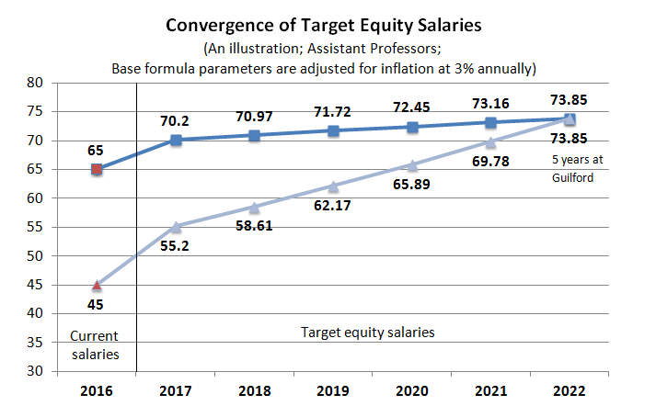
“Phase Out Market Factor Over Time”
Notes:
Natalya

Slide 19
Implementation - The proverbial devil is in the details
Once the Formula is established:
Create a FACULTY COMMITTEE to guide implementation and administration.
Create a TARGET SALARY for each current faculty member. SHARE it with them. Everyone should know their target and how it was determined.
Determine the COST of full implementation and estimate time to achieve it.
Establish a set of PRIORITIES for implementation based on Compensation Philosophy.
PHASE OUT salary increment based on academic discipline over time.
Notes:
Hiroko

Slide 20
Questions?
Feedback?
Suggestions?
Cautions?

Slide 21
End
Here

Slide 22
Hold these next 2 slides in case we need to refer to them

Slide 23
Implementation, continued
NEW FACULTY:
Hire at a rate that is equitable within their Guilford department [not their Target Salary]
Share Faculty Salary Equity Model with all incoming faculty so they know what to expect.
Provide new faculty with their Target Salary so they know what we are aiming for.
Move them toward their Target Salary in the same way as all other Guilford faculty.

