Slide 1
Making faculty service more fair, More efficient, and more rewarding
One Proposal
Three Ideas

Slide 2
Motivations
Develop a more efficient administrative structure with less redundancy, less wasted effort, and more space for teaching, collaboration, and research.
Reduce overwork by reducing the number of service positions and roles we are trying to fill, ideally by eliminating or consolidating roles with little to do.
Come up with a more equitable system for distribution of compensation (stipends and course releases) for service work, so that all who take on extra duties are compensated.

Slide 3
Proposal: lay down four committees
Ed Support
Ed Studies
Community Life
Tech Advisory

Slide 4
Motivations committee workload
Statement | Number Agreeing (out of 48) | Percent Agreeing
Some committees do not seem to do much work. | 43 | 90%
Committees with little or no workload should be laid down. | 31 | 65%

Slide 5
Motivations How evenly balanced is the workload between different committees and service positions?

Slide 6
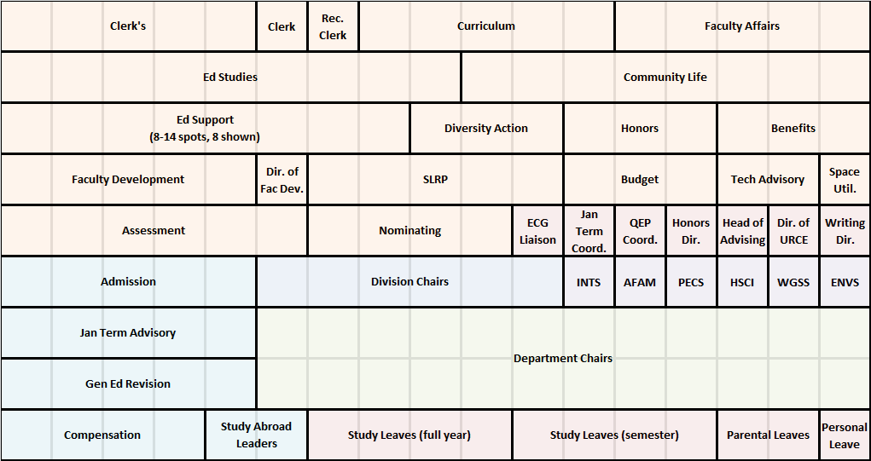
Motivations - Faculty Service Positions at Guilford
90 Tenured/Tenure Track Faculty cover this many spaces
means divisional representation required

Slide 7
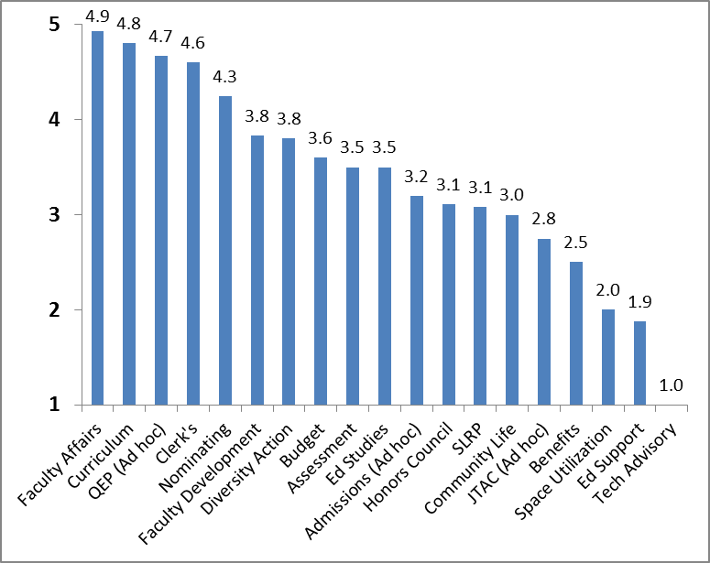
Motivations Perceived importance of work
5=vital
1=pointless

Slide 8
Motivations Workload (hours per year)

Slide 9
Proposal
Lay down four committees
Ed Support
Ed Studies
Tech Advisory
Community Life

Slide 10
Follow up
Replace or relocate vital functions
Ed Studies – occasional accreditation work
Community Life – honor code, judicial board, trustees/alumni rep
Educational Support Team - scholarships
Tech Advisory – figure out later

Slide 11
Ideas for new administrative structures & service Rewards
Faculty Forum
February 10th

Slide 12
Motivations
Develop a more efficient administrative structure with less redundancy, less wasted effort, and more space for teaching, collaboration, and research.
Reduce the number of service positions and roles we are trying to fill, ideally by eliminating or consolidating roles with little to do.
Come up with a more equitable system for distribution of compensation (stipends and course releases) for service work, so that all who take on extra duties are compensated.

Slide 13
Increase No. of Divisions Balance Division Staffing Remove obligations from Chairs Redesign Division Head Position
IDEA #1

Slide 14
Motivations - Faculty Service Positions at Guilford
90 Tenured/Tenure Track Faculty cover this many spaces
means divisional representation required

Slide 15
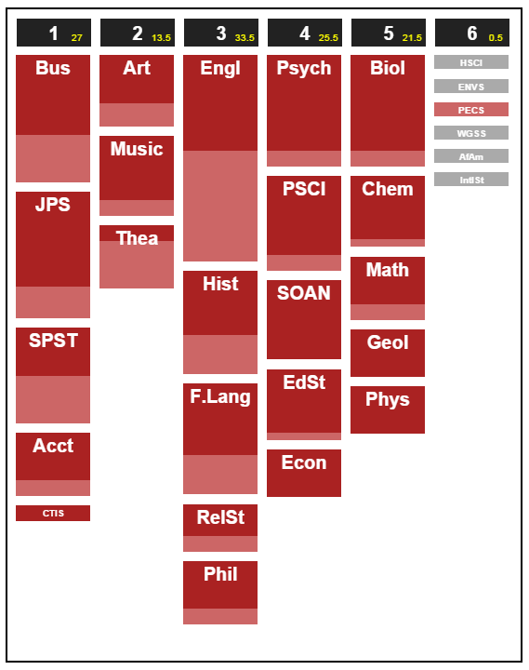
Existing Divisions
http://moonrm.com/depts
Current
Beth’s Idea

Slide 16
Pooled Service Rewards Earned by time served
IDEA #2

Slide 17
Motivations Distribution of rewards
In general, how fair and appropriate is the current assignment of rewards
(course releases and financial stipends) among various service positions?

Slide 18
Motivations Distribution of rewards

Slide 19
Motivations Workload (hours per year)
Department Chair (176)
Division Chair (109)

Slide 20
Idea: Service credits
Current rewards are pooled.
All service positions, chairs, and committees are re-evaluated by time and effort required. Each is assigned a service point value related to that time and effort.
Faculty members who serve in a position or on a committee earn the point value assigned to that role.

Slide 21
Rewards for Extra work
For extra duties a faculty member takes on during the year (e.g. ad hoc committee, education studies accreditation, search committee, Spring into Guilford), she or he can record the time spent in those roles and report it to Clerk’s (or Nominating) for review and awarding of points.

Slide 22
Baseline levels and rewards for extra service
A minimum expected service level would be specified. Faculty who fail to reach that level would be considered not to be fulfilling their service obligation.
Service points can be traded for course releases or stipends from the reward pool at an agreed-upon rate.

Slide 23
Remove Divisional Representation from some or all committees that require it
IDEA #3

Slide 24
Motivations
Currently, it is hard to meet the divisional representation requirement for all committees
Divisional representation forces faculty members from smaller divisions to serve frequently on high-workload committees
Requiring divisional representation can deny opportunities for people to serve where they most wish to serve

Slide 25
Additional benefit
This year, students and others have led us to increase diversity of representation on committees. Relaxing divisional representation allows us more freedom to seek diversity other than disciplinary on important committees.

Slide 26
Idea
Remove divisional representation from some or all committees which require it
Curriculum
Clerk’s
SLRP (now SPOC)
FAC
LAGER
Jan Term Advisory
Admissions ad hoc (goal, not requirement)

Slide 27
Complications
For some committees, this is potentially problematic, as differences in pedagogy or methodology could be key to their business – e.g. FAC, Curriculum
Option 1: Retain divisional representation (or equivalent) on those committees
Option 2: Ensure through separate language or structures a variety of pedagogies and perspectives on key committees

